Slide 1


LSQL: Student-Manage System Based on I-Node FS
Members ：全秦霄、李宇扬、李伟杰、石寒雪

Slide 2

CONTENTS
1
Communications structure
4
System Command
Content overview and division of labor
2
I-Node
File System
5
3
Student Management System

Slide 3

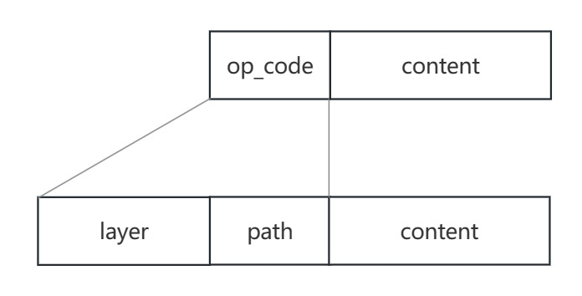
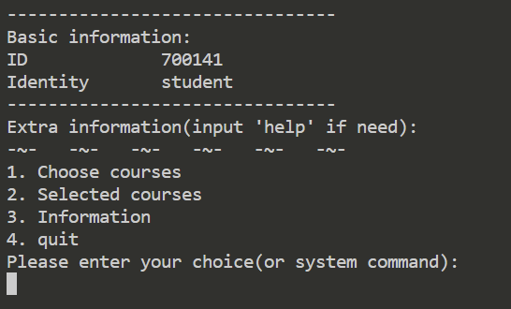

Option Implementation
Option storage method:
The client displays:
Communication Structure
I-Node File System
Student-Manage System
Instance (total function table):
System Command
Content overview and division of labor

Slide 4
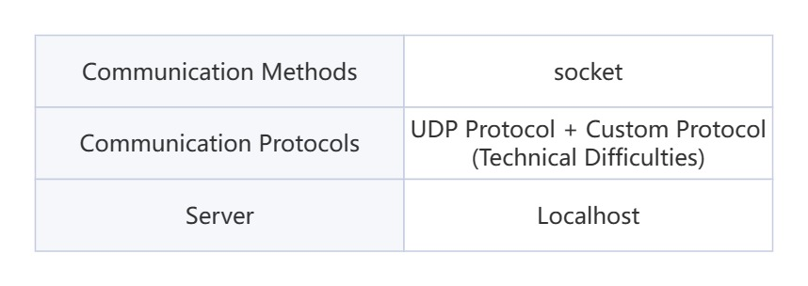
Basic information
Communication Structure
I-Node File System
Student-Manage System
System Command
Content overview and division of labor

Slide 5
Custom Protocol Communication:
Communication Structure
The cause of the problem: competition
Identify each endpoint: 10000 – 19999 address
Special ports: 10000 server ports
10001 The fictitious address at the time of request
Package with added header (in parentheses):
(Operation type | Destination | place of issue) content
I-Node File System
Student-Manage System
System Command
Content overview and division of labor

Slide 6

Custom Protocol Communication:
Verification method 1:
The request for the application address sent by the virtual address
The type of operation
destination
Communication Structure
I-Node File System
Student-Manage System
Verification method 2: General request (The user's address will be recorded after the thread is opened.)
The type of operation
Destination
Place of origin
System Command
Content overview and division of labor

Slide 7
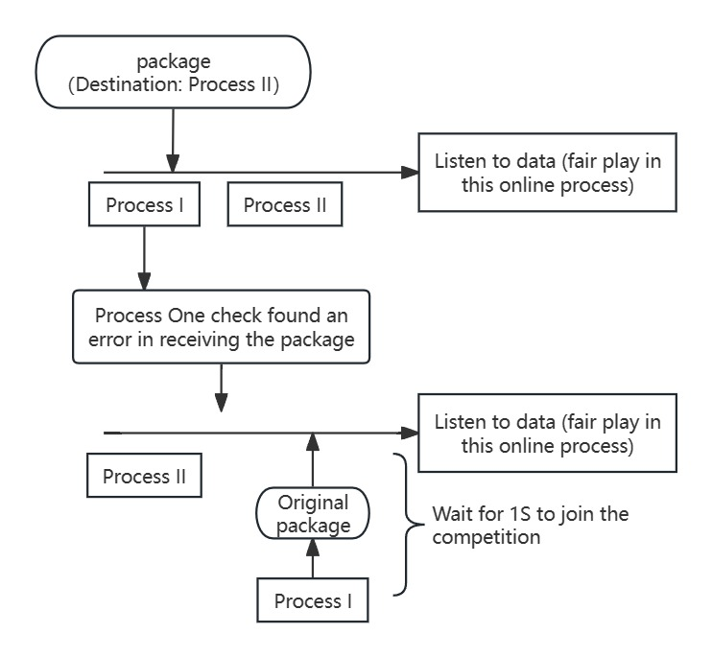
Error Packet Handling
(Active Exit from Competition):
Communication Structure
I-Node File System
Student-Manage System
System Command
Content overview and division of labor

Slide 8
Communication Structure
I-Node File System
Student-Manage System
System Command
Content overview and division of labor

Slide 9
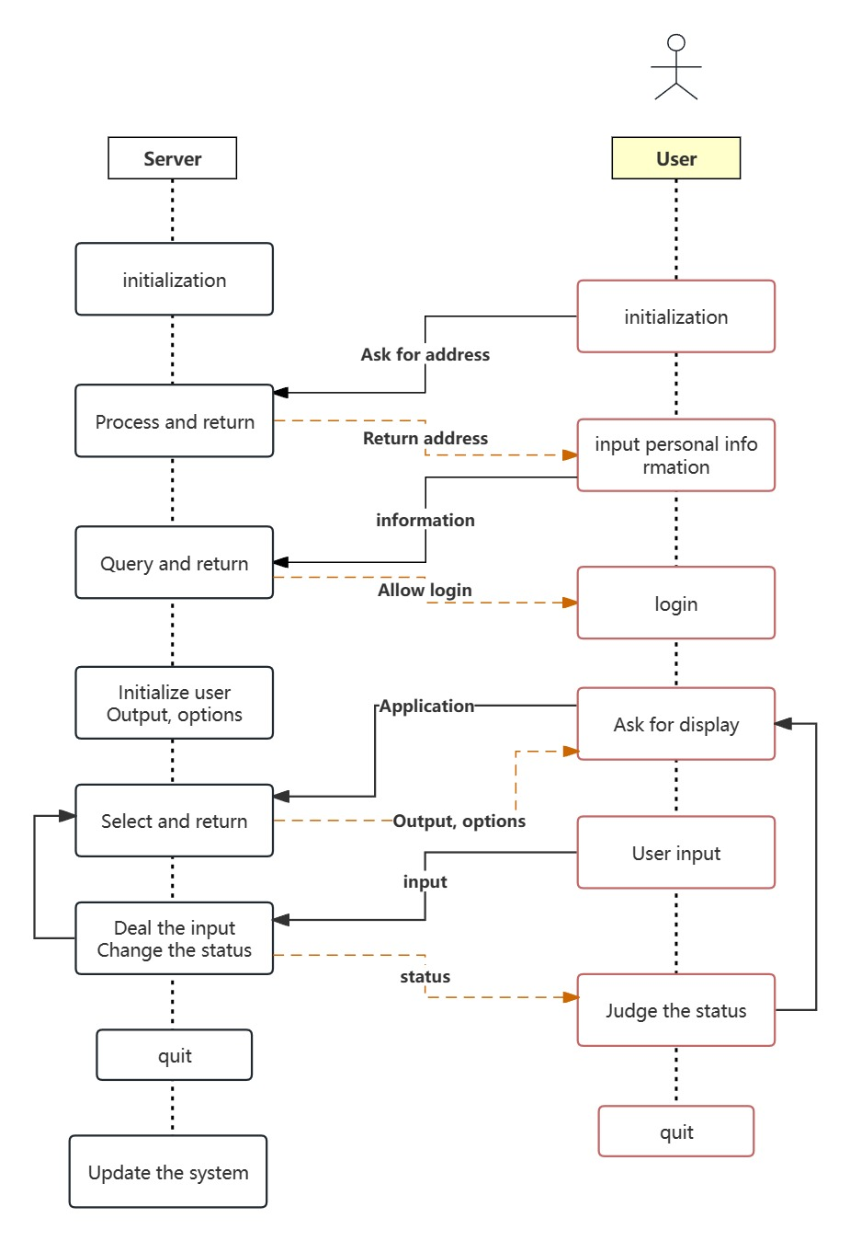
Pre-login process
Communication Structure
I-Node File System
Student-Manage System
System Command
Content overview and division of labor
Notes:
初始化
申请真实地址
开启新线程
输入账号密码
进入登录后

Slide 10
Post-login process
Communication Structure
I-Node File System
Student-Manage System
System Command
Content overview and division of labor
Notes:
初始化output和options

Slide 11
Post-login process
Communication Structure
I-Node File System
Student-Manage System
System Command
Content overview and division of labor
Notes:
如图所示。。。

Slide 12
Post-login process
Communication Structure
I-Node File System
Student-Manage System
System Command
Content overview and division of labor
Notes:
用户申请显示选项
服务器端筛选返回并接收用户输入
用户输入后，服务器端处理，更新用户状态并返回

Slide 13
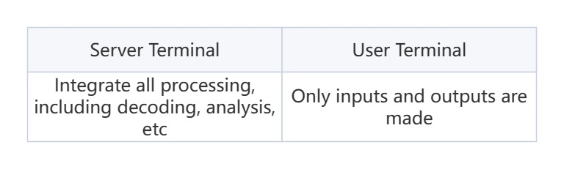
Double-ended architecture
Communication Structure
I-Node File System
Student-Manage System
System Command
Content overview and division of labor

Slide 14
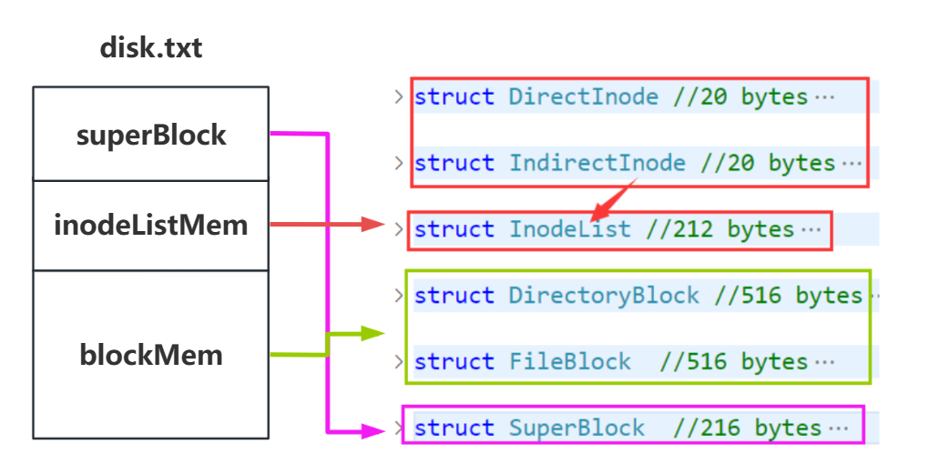
‘disk.txt’ analog disk
Communication Structure
I-Node File System
Student-Manage System
System Command
Content overview and division of labor

Slide 15
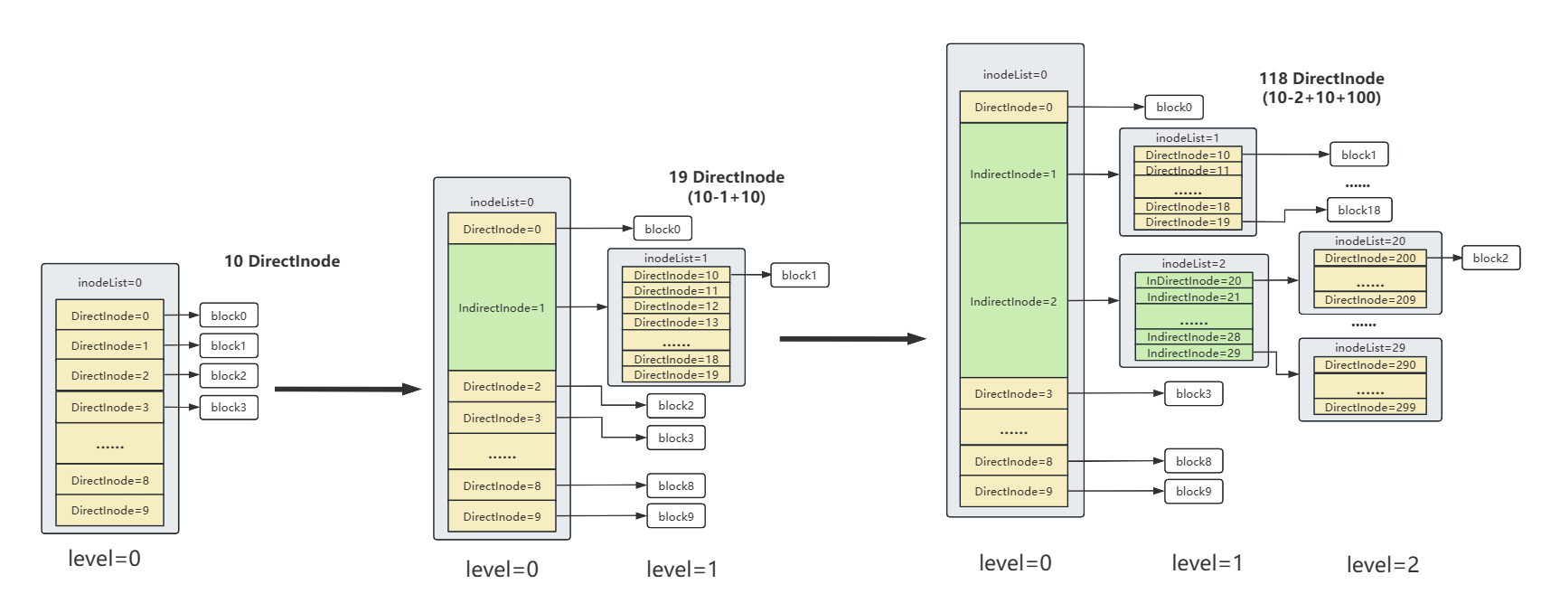
File System Infrastructure
Communication Structure
I-Node File System
Student-Manage System
System Command
Content overview and division of labor

Slide 16
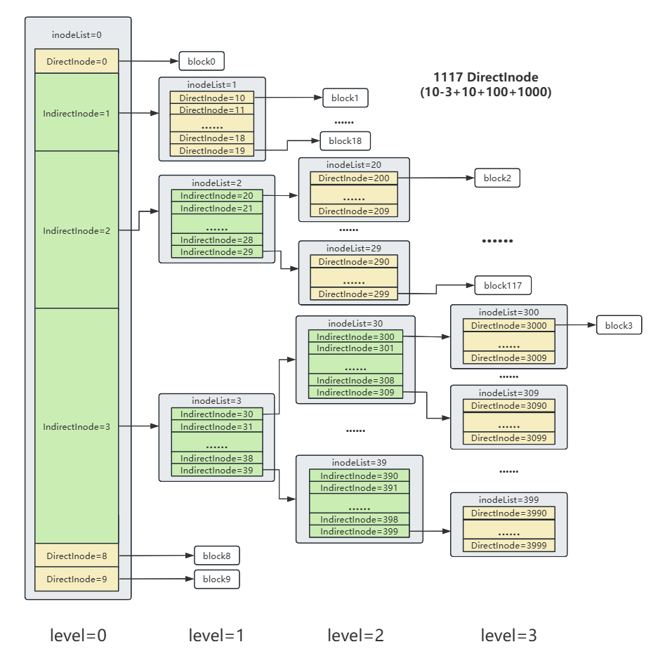
I-Node Dynamic expansion
Communication Structure
I-Node File System
Student-Manage System
System Command
Content overview and division of labor

Slide 17
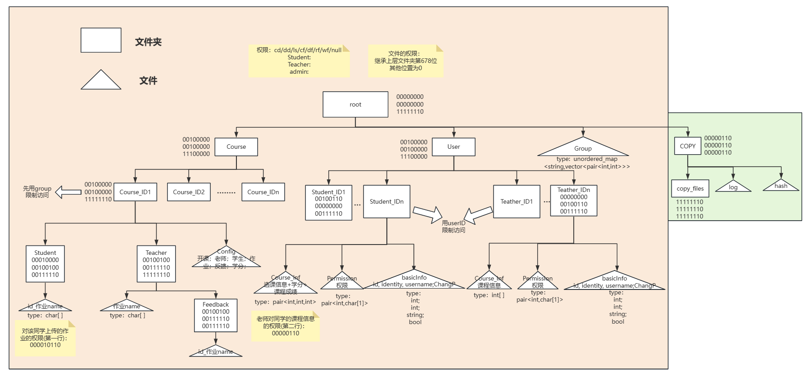
Project File System Structure
Communication Structure
I-Node File System
Student-Manage System
System Command
Content overview and division of labor

Slide 18
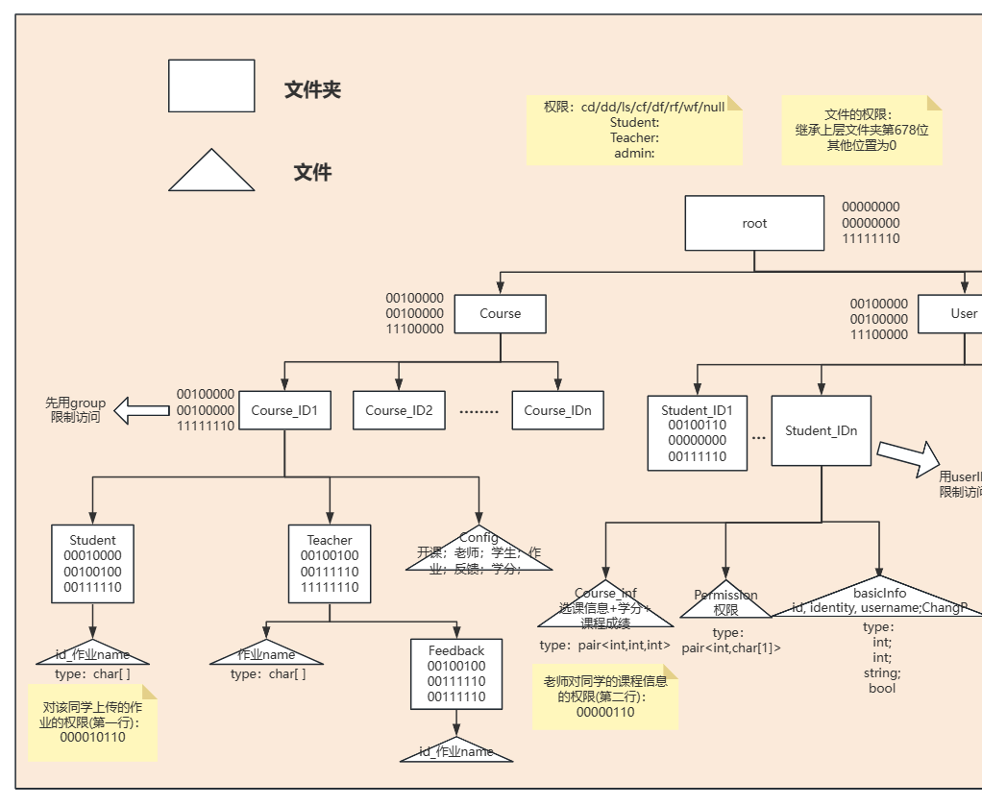
Permission
Communication Structure
I-Node File System
Student-Manage System
System Command
Content overview and division of labor

Slide 19
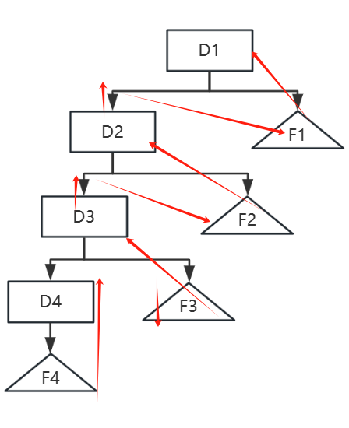
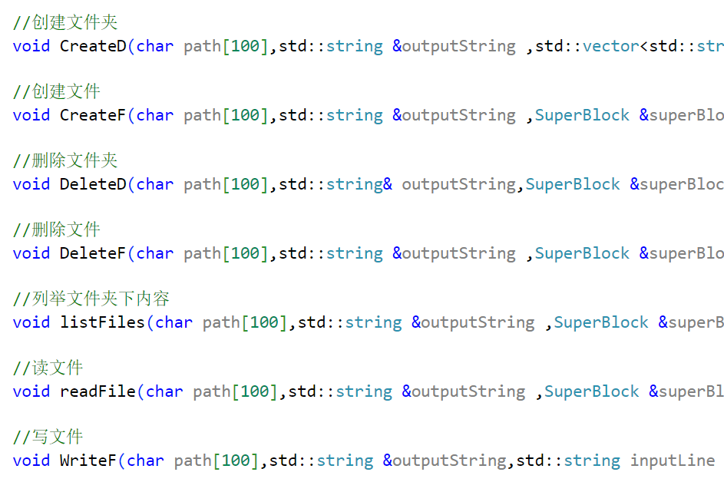
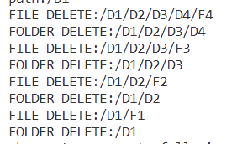
Underlying Functions
Communication Structure
I-Node File System
Student-Manage System
System Command
Content overview and division of labor
Allow files and folders with the same name in the same directory

Slide 20
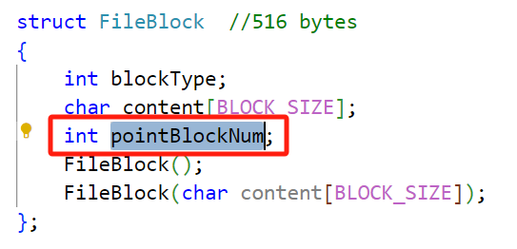
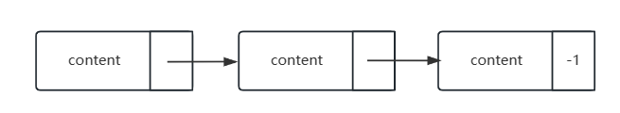
Large file reading and writing
Communication Structure
I-Node File System
Student-Manage System
System Command
Content overview and division of labor

Slide 21
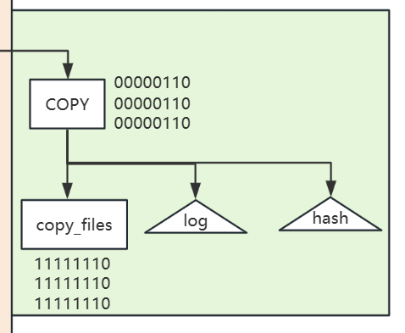
Snapshot Recovery
Communication Structure
When a backup operation is performed:
Hash is updated only at the first change operation on the file.
But log is logged at every operation.
I-Node File System
Student-Manage System
System Command
Improve backup recovery efficiency
Save disk space
Content overview and division of labor

Slide 22
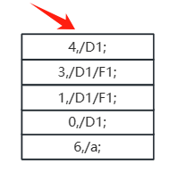
Snapshot Recovery
Log format: opcode, path;
Opcode：
Communication Structure
0: Create folder
1: Create file
2: Delete File
3: Delete files in a folder which is deleted
4: Delete folder in a folder which is deleted
6: Write file
7: Add user
8: Change password
0: Delete folder
1: Delete file
2: Create file + write file
3: Create File + Write File
4: Create Folder
6: Write File
7: Delete user
8: Change password
I-Node File System
Recovery
Student-Manage System
System Command
Content overview and division of labor

Slide 23
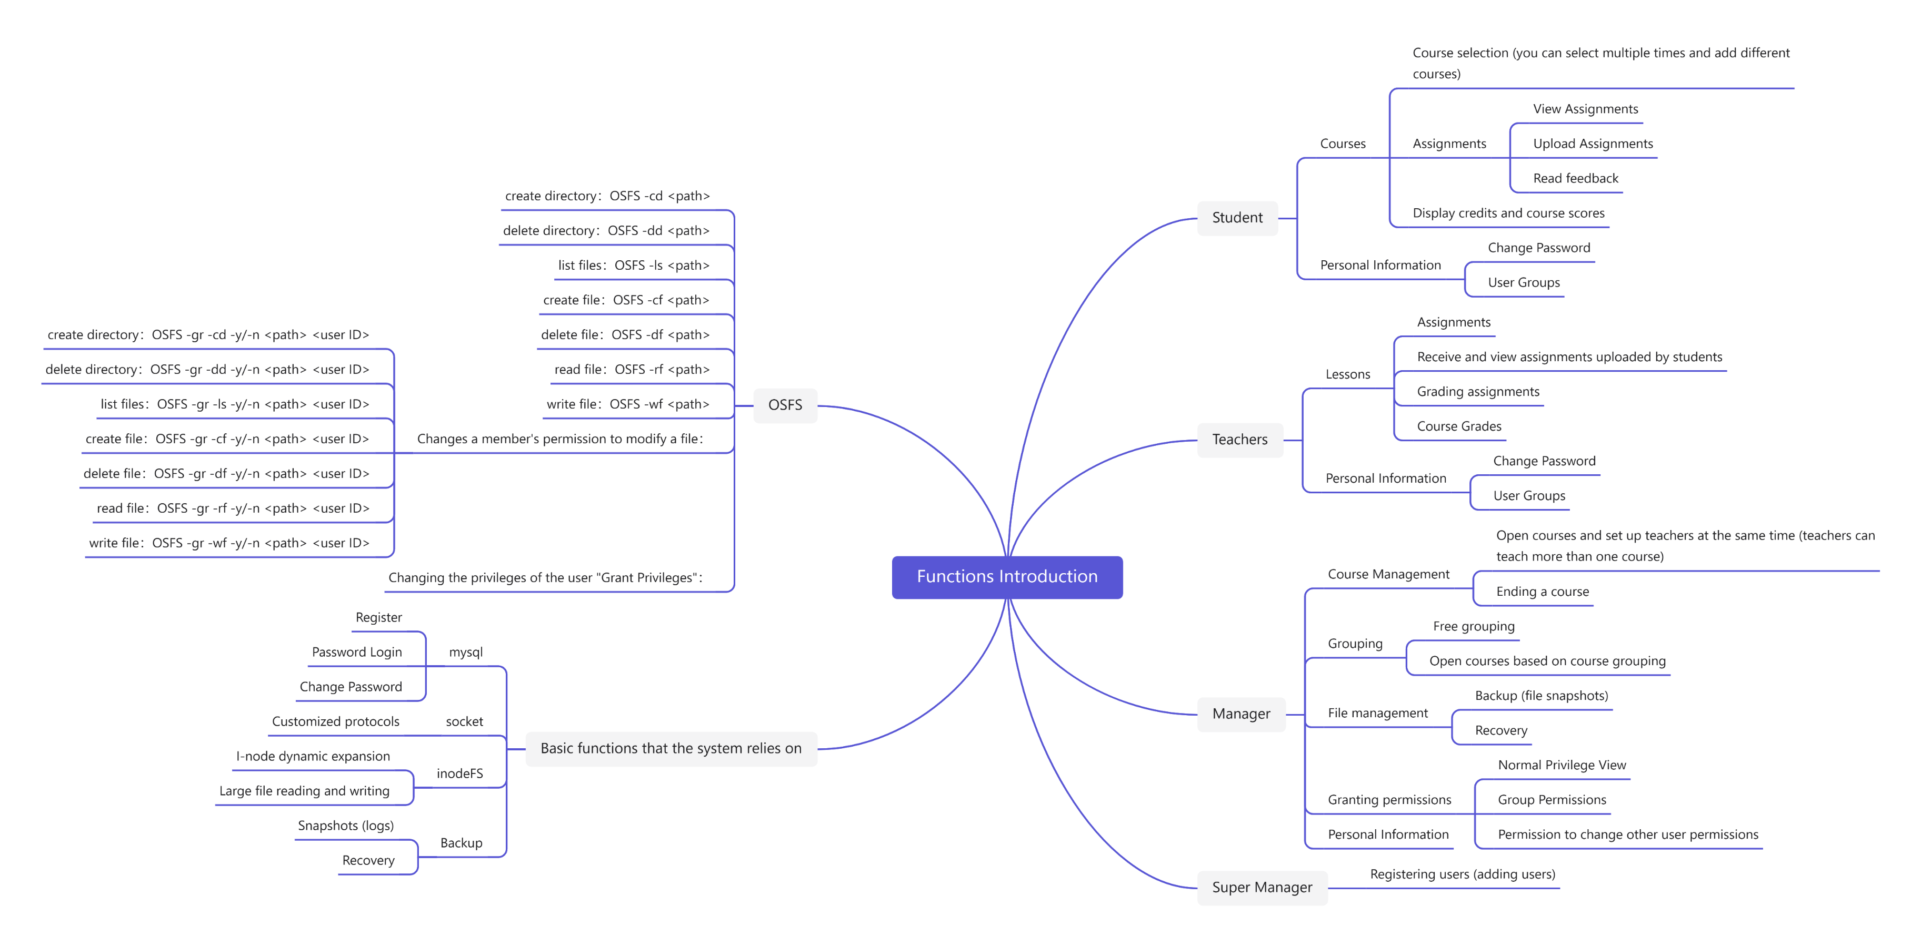
Function Overview
0000
0
。。
Communication Structure
I-Node File System
Student-Manage System
System Command
Content overview and division of labor

Slide 24
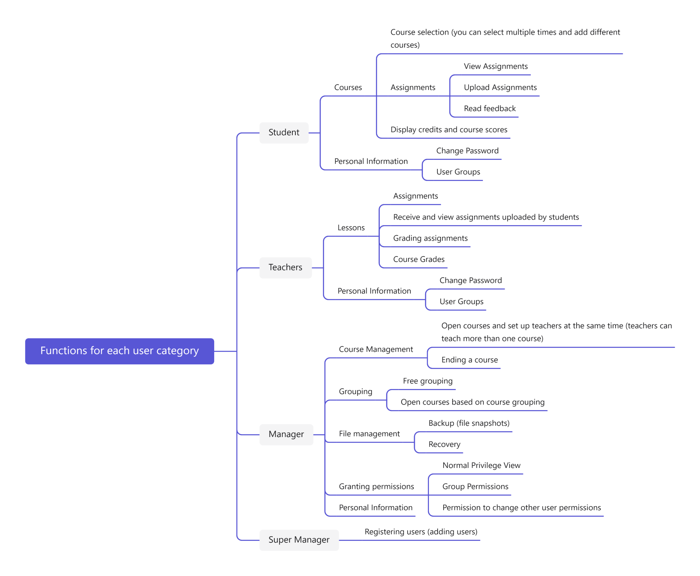
System Functions
0000
0
。。
Communication Structure
I-Node File System
Student-Manage System
System Command
Content overview and division of labor

Slide 25
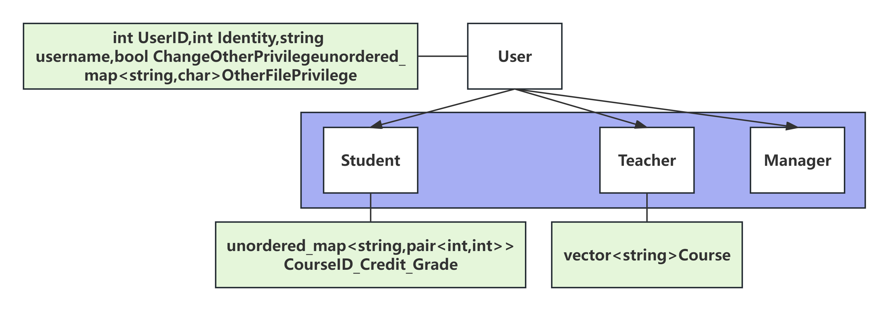
Relationship between Classes
Communication Structure
I-Node File System
- Using C++ inheritance
- User is used as a base class to store the basic information of the user and the permission information;
- Student and Teacher are used as subclasses to record course information.
- It realizes the separation of the management of permission information and user course information.
Student-Manage System
System Command
Content overview and division of labor

Slide 26
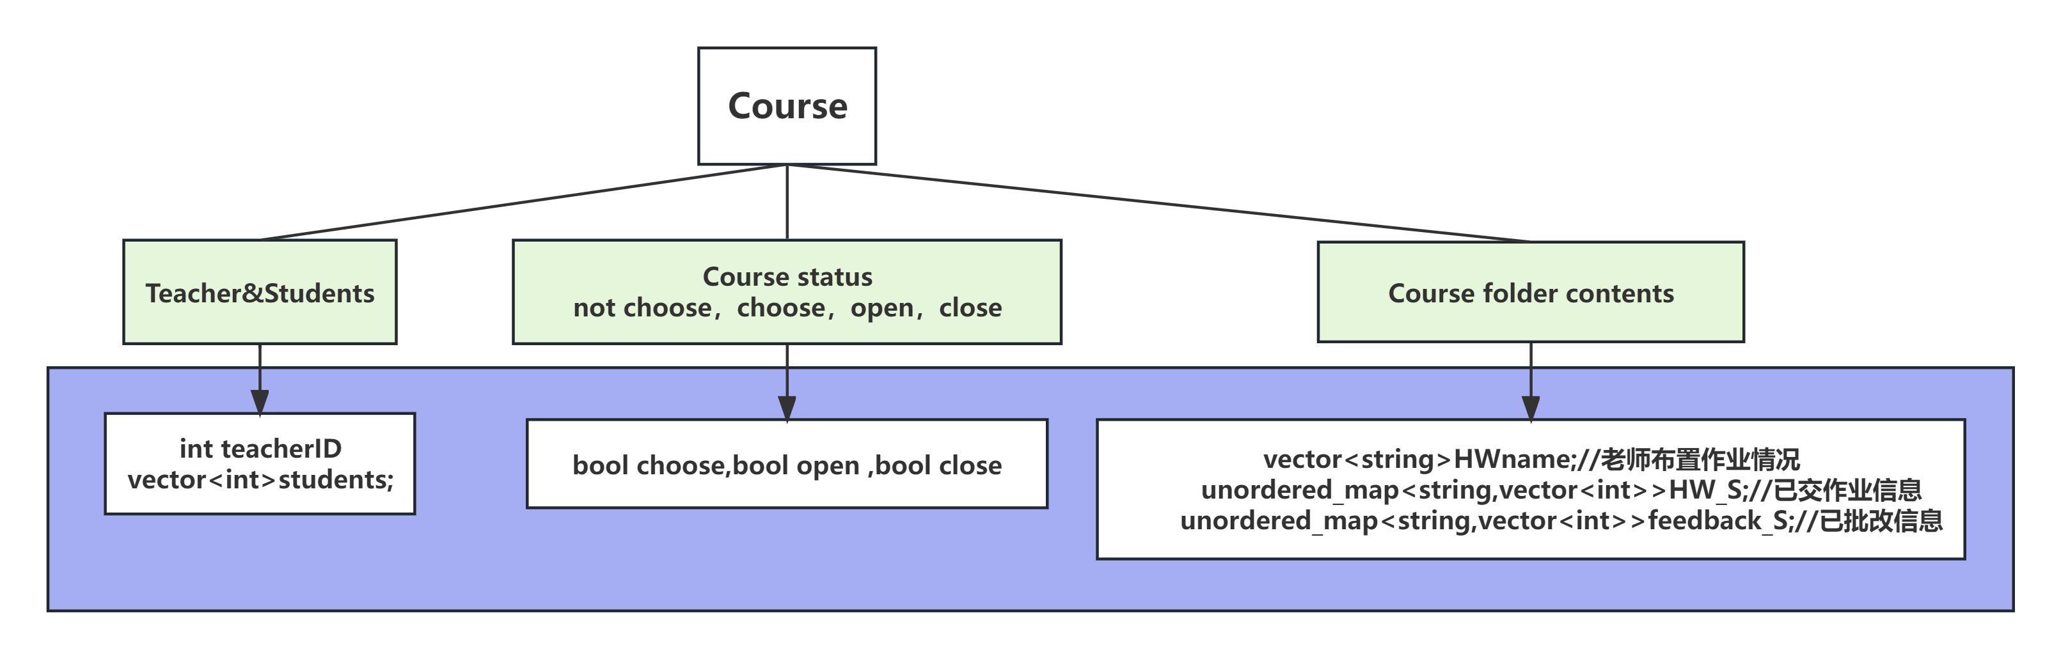
illegal input
Communication Structure
I-Node File System
Student-Manage System
- Course objects are not file system aware and need to be provisioned with relevant file content information for detecting illegal input.
- Example: Teacher needs to correct students who have handed in their assignments; HW_S records the students who have handed in their assignments; avoid accessing non-existent files.
System Command
Content overview and division of labor

Slide 27
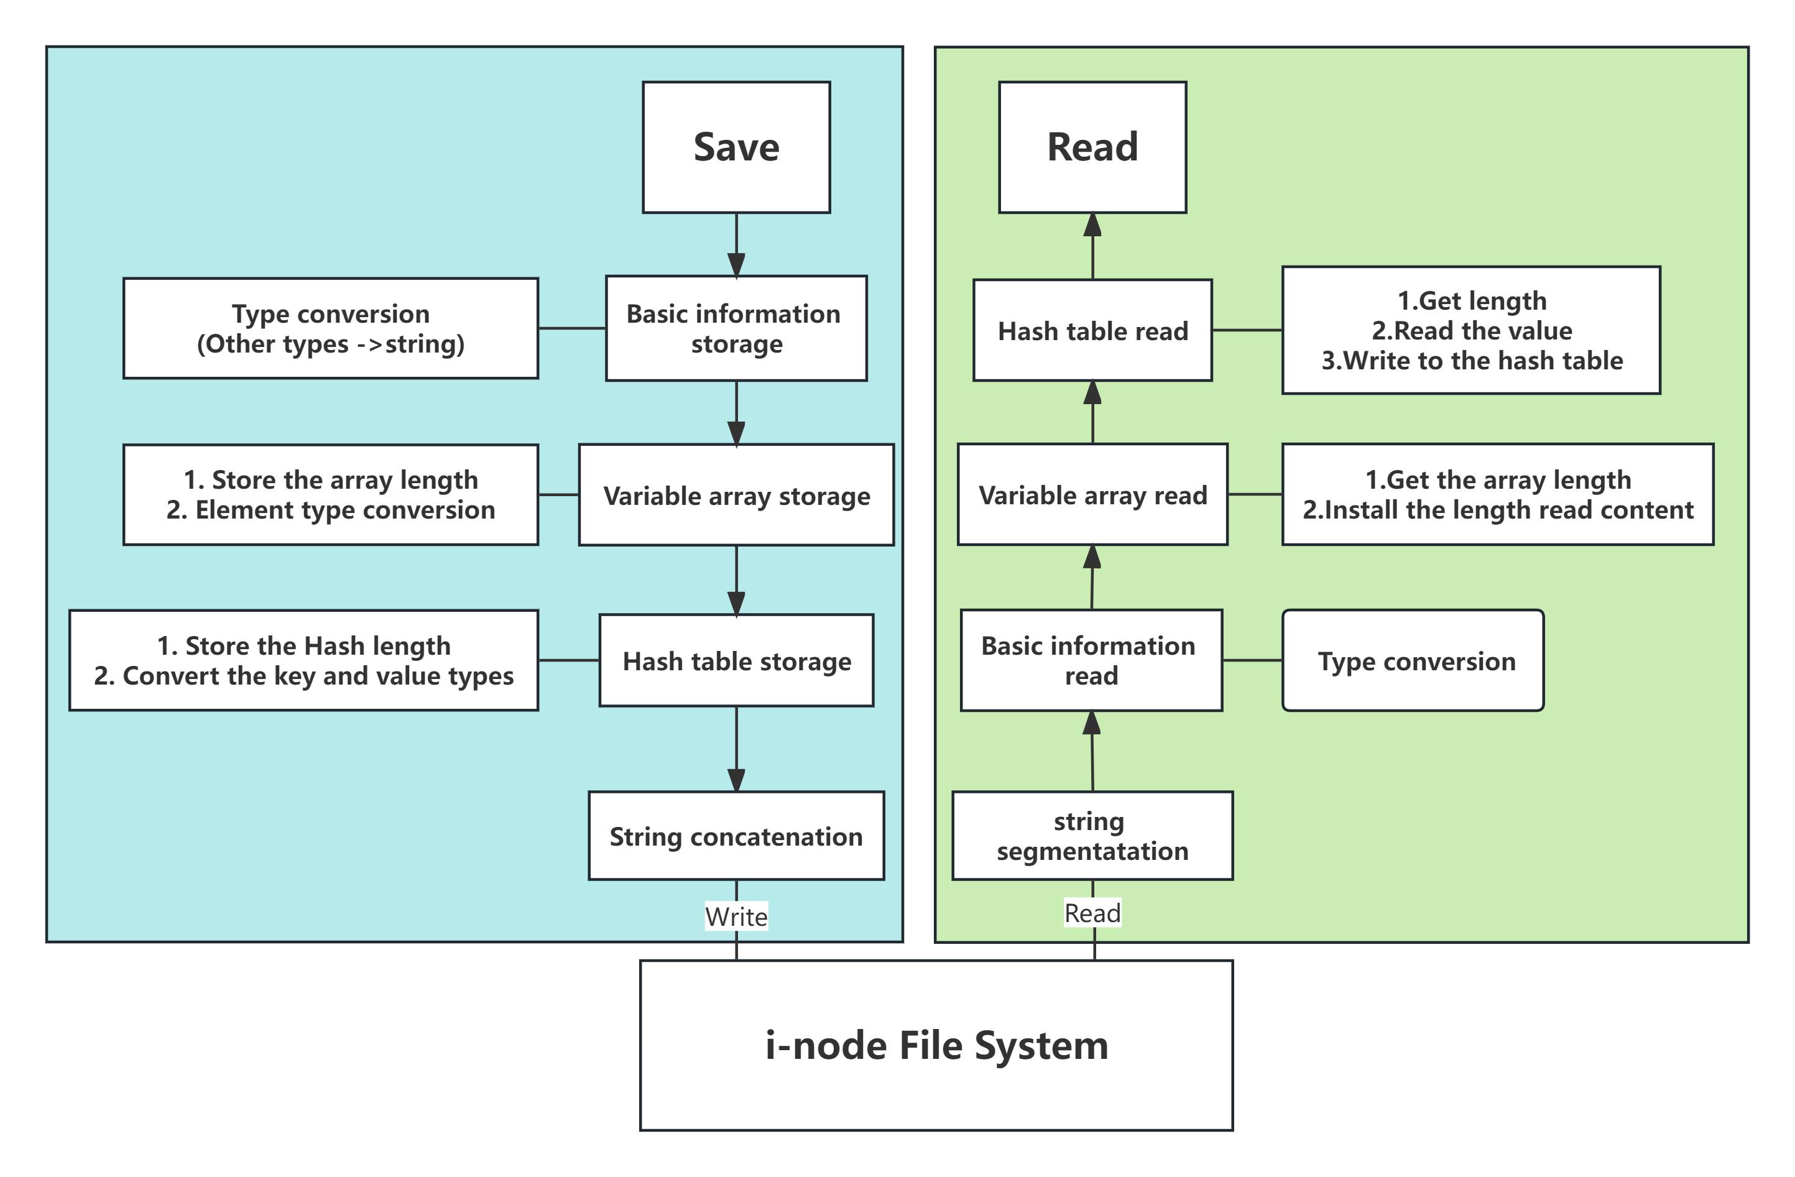
H2S read-write protocol
Communication Structure
I-Node File System
Student-Manage System
System Command
Content overview and division of labor

Slide 28
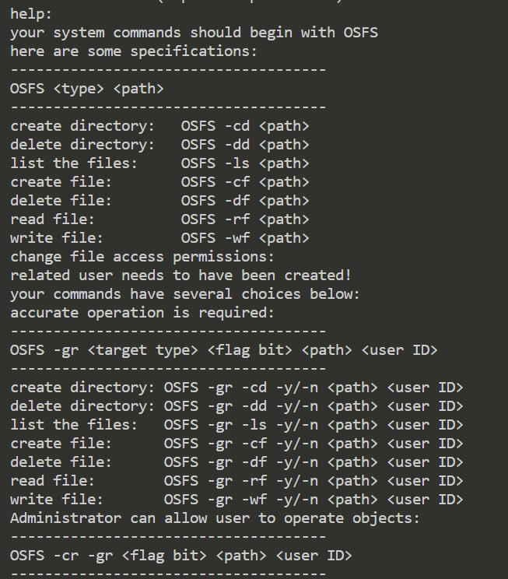
System commands interface
The system commands are implemented in order to better demonstrate the file management and permission operation functions.
The prompt interface displayed on the user side is shown in the figure containing all the implemented file system functions.
Communication Structure
。
。
。
I-Node File System
Student-Manage System
System Command
Content overview and division of labor

Slide 29
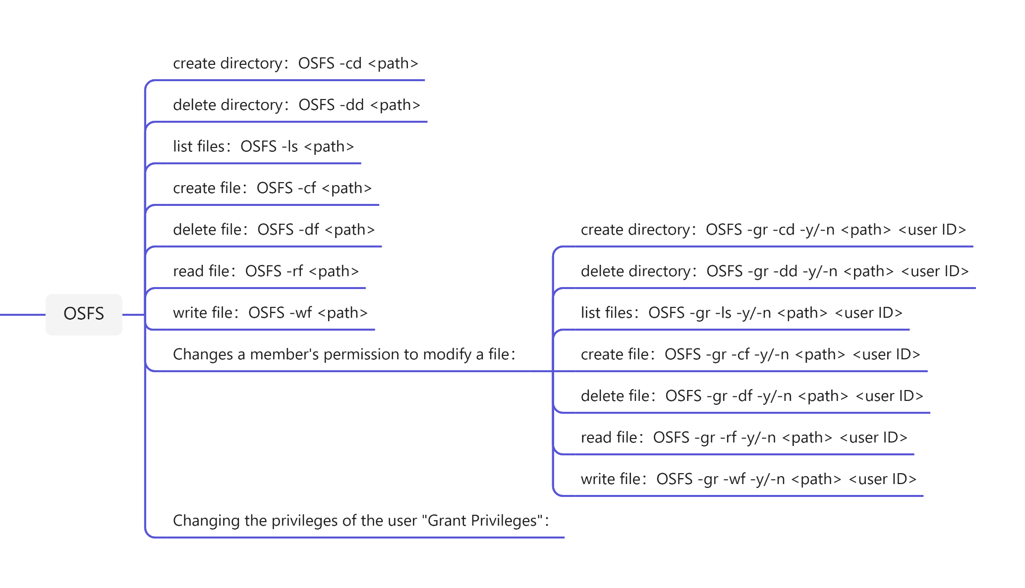
List of system commands
Communication Structure
I-Node File System
Student-Manage System
System Command
Content overview and division of labor

Slide 30
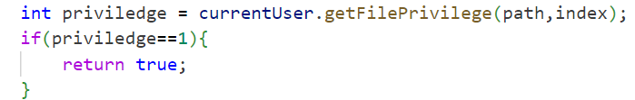
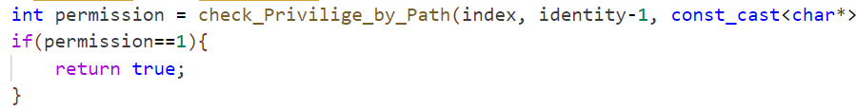
Permission Determination
01
If administrator:
Communication Structure
Can have all file operation permissions, permissions to change others' permissions, and permissions to give users the ability to change others' permissions.
I-Node File System
02
Checks the permissions of a specific file in this path for this specified user.
Student-Manage System
System Command
Content overview and division of labor
03
Check if the corresponding specific permissions are available for the i-node in this location.

Slide 31
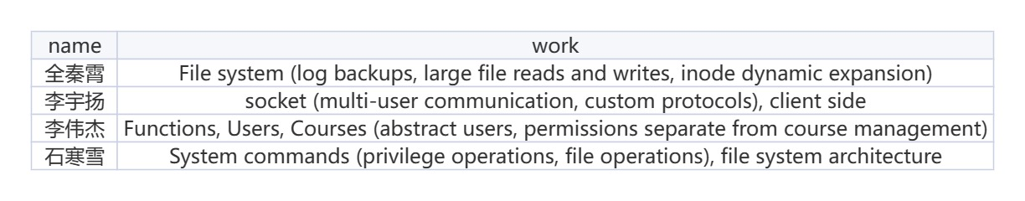
Communication Structure
I-Node File System
Student-Manage System
System Command
Content overview and division of labor

Slide 32
Communication Structure
The PPT explanation part has ended.
This is followed by a presentation of the results for the defense.
I-Node File System
Student-Manage System
System Command
Content overview and division of labor

Slide 33
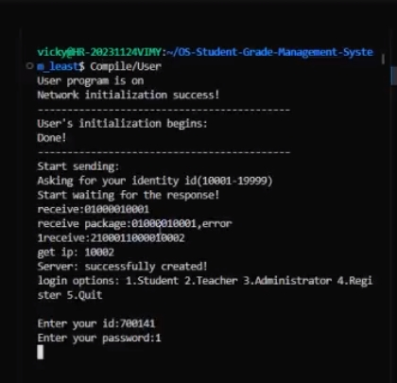
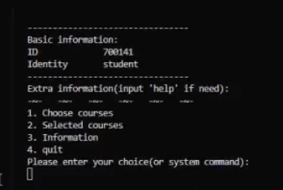
login function
0000
0
。。
Communication Structure
I-Node File System
Student-Manage System
System Command
Content overview and division of labor
Launch the client, enter the account password Login Successfully

Slide 34
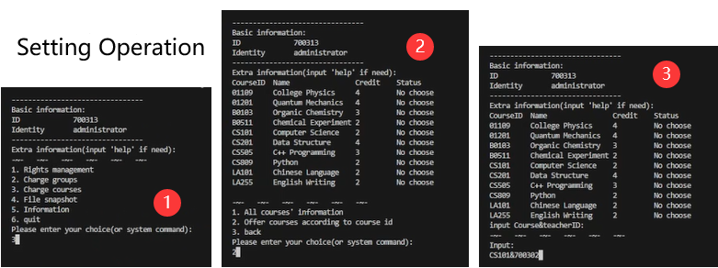
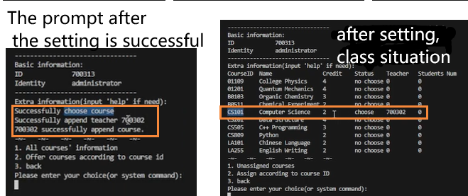
Course Selection Function
Go to the Open Course page and enter the course ID and instructor ID.
The course was opened successfully.
Communication Structure
I-Node File System
Student-Manage System
System Command
Content overview and division of labor

Slide 35
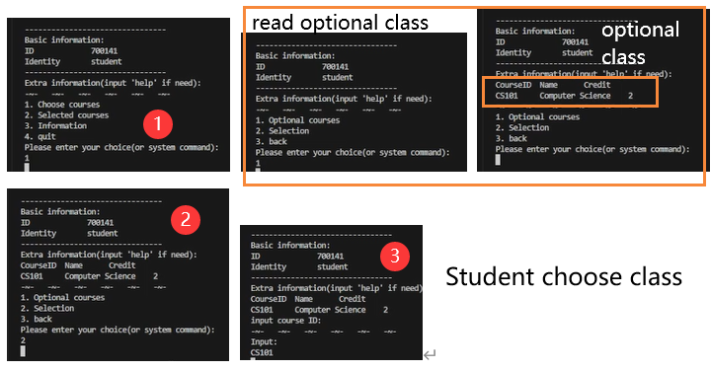
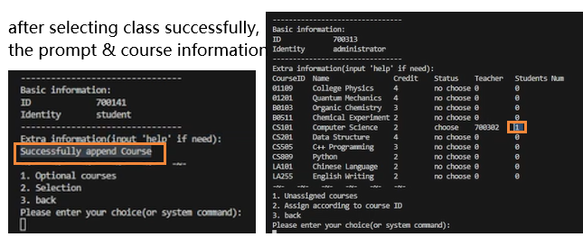
Course Selection Function
View All Available Courses
Select Course
Selection Successful
Communication Structure
I-Node File System
Student-Manage System
System Command
Content overview and division of labor

Slide 36
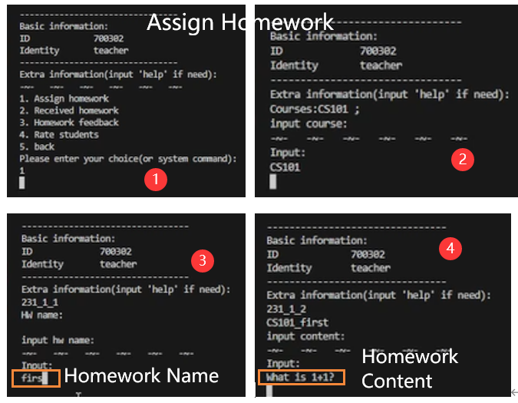
homework assignment function
Log in to your teacher account and go to the course selection page
Communication Structure
I-Node File System
Enter the course ID and assignment name
Student-Manage System
System Command
Enter the contents of the assignment
Content overview and division of labor

Slide 37
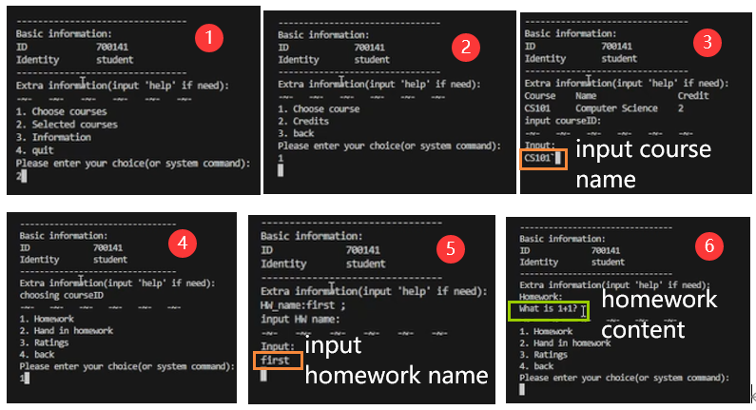
View Assignment function
Communication Structure
I-Node File System
Student-Manage System
System Command
Content overview and division of labor
Student enters course ID and assignment name to view course assignments

Slide 38
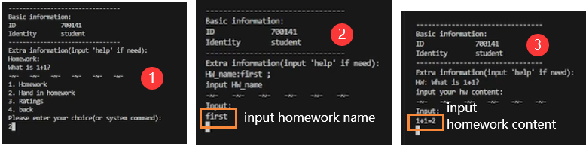
View Assignment function
Communication Structure
I-Node File System
Student-Manage System
System Command
Content overview and division of labor
Students enter answers to assignments and upload assignments

Slide 39
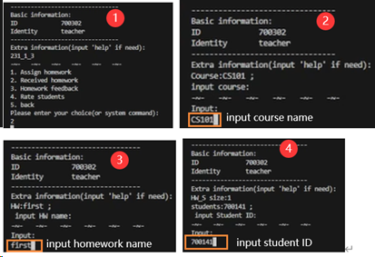
View Assignment function
Teacher inputs course ID, assignment name to view student turned in assignments
Communication Structure
I-Node File System
Student-Manage System
System Command
Content overview and division of labor
Teachers enter student IDs to view student work

Slide 40
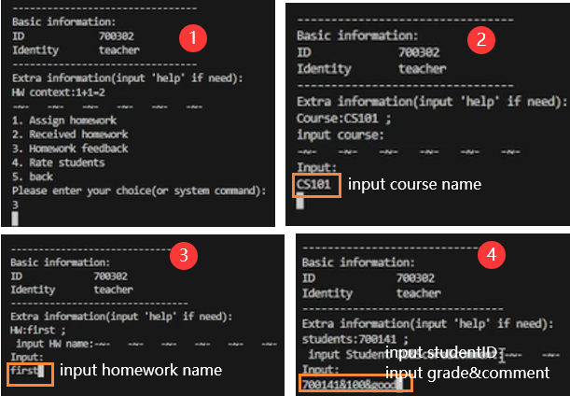
Correct homework, view homework feedback function
Communication Structure
I-Node File System
Student-Manage System
System Command
Content overview and division of labor
Teacher enters scores and evaluations, corrects assignments

Slide 41
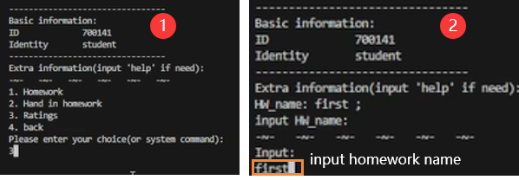
Correct homework, view homework feedback function
Communication Structure
I-Node File System
Student-Manage System
System Command
Content overview and division of labor
Students view assignment evaluations

Slide 42
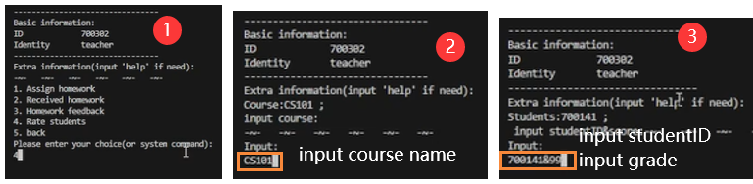
End-of-Course Functions
Communication Structure
I-Node File System
Student-Manage System
System Command
Content overview and division of labor
Teacher enters overall grade

Slide 43
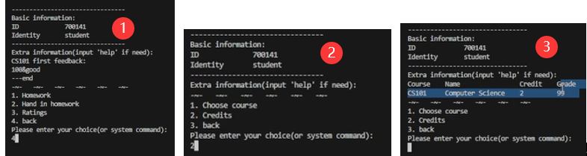
End-of-Course Functions
Communication Structure
I-Node File System
Student-Manage System
System Command
Content overview and division of labor
Student views overall grade

Slide 44
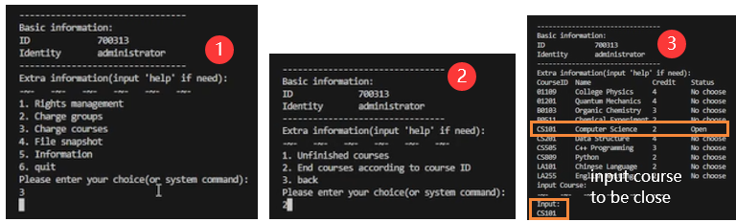
End-of-Course Functions
Communication Structure
I-Node File System
Student-Manage System
System Command
Content overview and division of labor
Administrator closes course

Slide 45
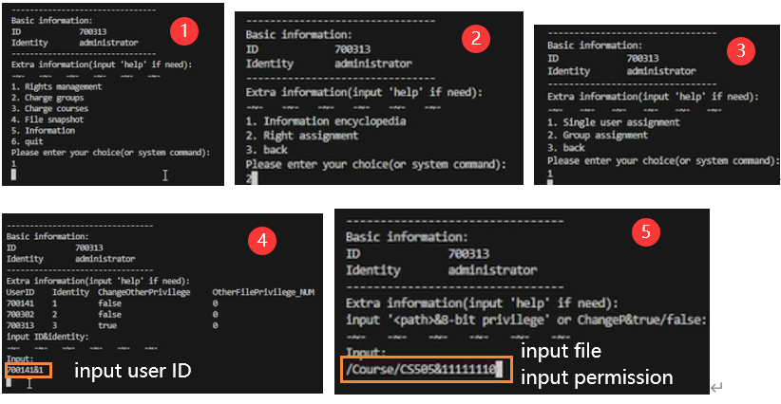
User-level permission
Communication Structure
I-Node File System
Student-Manage System
System Command
Content overview and division of labor
initial permission
Give CS505 course folder permissions to student 700141

Slide 46
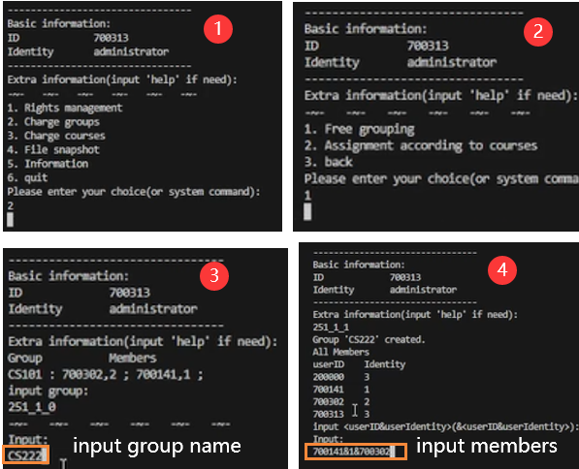
Free grouping function
Communication Structure
I-Node File System
Creating a new group
Student-Manage System
System Command
Setting the initial members of a group
Content overview and division of labor

Slide 47
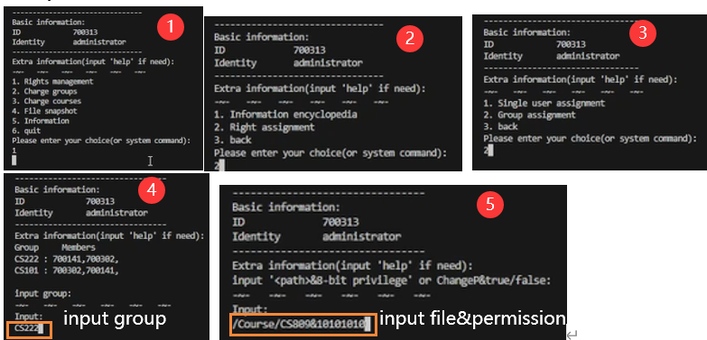
Group Permission Assignment Function
Communication Structure
I-Node File System
Student-Manage System
System Command
Content overview and division of labor
Give the CS222 group permissions to the CS809 course folder
initial permission
new permission

